Slide 1
Code Optimization

Slide 2
Code Optimization
Most complexity in modern compilers is in the optimizer
Also by far the largest phase
Optimizations can be performed on
AST / DAG
Machine independent optimization but too high level
Assembly code
Target (machine) dependent optimization
On an intermediate language

Slide 3
Basic Blocks
A basic block is a maximal sequence of instructions with:
no labels (except at the first instruction), and
no jumps (except in the last instruction)
Idea:
Cannot jump into a basic block (except at beginning)
Cannot jump out of a basic block (except at end)
A basic block is a single-entry, single-exit, straight-line code segment
The property of sequential control flow can be useful for many optimizations.

Slide 4
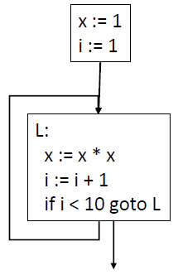
Control Flow Graphs
Control-Flow Graph (CFG)
Models the way that the code transfers control between blocks in the procedure.
Node: a single basic block
Edge: transfer of control between basic blocks.
All return nodes are terminal

Slide 5
Code Optimization
Optimization seeks to improve a program’s resource utilization
Execution time (most often)
Code size
Network messages sent
Memory Usages
Disk Accesses
Power
Optimization should not alter what the program computes
The answer before and after optimization must remain same

Slide 6
Code Optimization
There are three granularities of optimizations
Local optimizations
Apply to a basic block in isolation
Global optimizations
Apply to a control-flow graph (method body) in isolation
Inter-procedural optimizations
Apply across method boundaries
Most compilers do local and global optimizations but not the third
Often a conscious decision is made not to implement the fanciest optimization known
Goal: Maximum benefit for minimum cost

Slide 7
Local Optimization
Algebraic simplification and Reassociation
Simplifications use algebraic properties or particular operator-operand combinations to simplify expressions.
Reassociation refers to using properties such as associativity, commutativity and distributivity to rearrange an expression to enable other optimizations

Slide 8
Local Optimization
Algebraic simplification and Reassociation
Simplification Examples:
Example: Re-arrangement + constant folding
x+0 = x 0+x = x x*1 = x 1*x = x 0/x = 0 x-0 = x
b && true = b b && false = false
b || true = true b || false = b
b = 5 + a + 10 ;
t0 = 5 ;
t1 = t0 + a ;
t2 = t1 + 10 ;
b = t2 ;
t0 = 15 ;
t1 = a + t0 ;
b = t1 ;

Slide 9
Local Optimization
Constant Folding
Evaluation at compile-time of expressions whose operands are known to be constant
Example
t0 = 10 ;
t1 = 5 ;
t2 = t0 * t1 ;
t3 = 6 ;
t4 = t2 + t3 ;
t5 = t4 – b;
a = t5 ;
t0 = 56 ;
t1 = t0 – b ;
a = t1 ;
a = 10 * 5 + 6 - b;

Slide 10
Code Optimization
…. to continue

Slide 11
Local Optimization
Constant Propagation
If a variable is assigned a constant value, then subsequent uses of that variable can be replaced by the constant as long as no intervening assignment has changed the value of the variable.
Example:
t0 = 12 ;
t1 = arr + t0 ;
t2 = *(t1) ;
t0 = *(arr + 12) ;
Constant propagation + rearrangement cuts no. of regs. and insns. from 4 to 2
lw $t0, 8($fp)
lw $t1, 12($t0)
li $t0, 12
lw $t1, 8($fp)
add $t2, $t1, $t0
lw $t3, 0($t2)

Slide 12
Local Optimization
Operator Strength Reduction
Replaces an operator by a "less expensive" one
Often performed as part of loop-induction variable elimination
Example:
t1 = i;
L0:
If t1>100 Goto L1 ;
t2 = 4 * t1 ;
t3 = arr + t2 ;
*(t3) = 0 ;
t1 = t1 + 1 ;
Jump L0
L1:
t1 = arr ;
L0: If i > 100 Goto L1 ;
* t1 = 0;
t1 = t1 + 4;
i = i + 1 ;
L1:
while (i < 100) {
arr[i] = 0;
i = i + 1;
}

Slide 13
Local Optimization
Copy Propagation
Similar to constant propagation, but generalized to non-constant values
For a = b, we can replace later occurrences of a with b (assuming there are no changes to either variable in-between)
Example
t2 = t1 ;
t3 = t2 * t1;
t4 = t3 ;
t5 = t3 * t2 ;
c = t5 + t4 ;
t3 = t1 * t1 ;
t5 = t3 * t1 ;
c = t5 + t3 ;

Slide 14
Dead Code Elimination
Remove code which does not affect the program results.
Benefits:
It shrinks program size
It allows the running program to avoid executing irrelevant operations and thus reduces running time.
Dead code includes:
Code that is never be executed (unreachable code)
Code that only affects dead variables, that is, variables whose definition remains unused.

Slide 15
Dead Code Elimination
int foo(void) {
int a = 24;
int b = 25; /* Assignment to dead variable */
int c;
c = a << 2;
return c;
b = 24; /* Unreachable code */
return 0; /* Unreachable code */
}

Slide 16
Common Sub-expression Elimination (CSE)
Two operations are common if they produce the same result.
An expression is alive if the operands used to compute the expression have not been changed.
An expression not alive is dead.
CSE searches for instances of expressions that evaluate to the same value and analyses if it may be replaced with a single variable holding the computed value.
a = b * c + g;
d = b * c * d;
tmp = b * c;
a = tmp + g;
d = tmp * d;
CSE done by using “tmp” in the definition of “d”

Slide 17
Local Optimization Example
a := x ** 2
b := 3
c := x
d := c * c
e := b * 2
f := a + d
g := e * f
Operator strength reduction

Slide 18
Local Optimization Example
a := x * x
b := 3
c := x
d := c * c
e := b << 1
f := a + d
g := e * f
Constant and copy propagation

Slide 19
Local Optimization Example
a := x * x
b := 3
c := x
d := x * x
e := 3 << 1
f := a + d
g := e * f
Constant folding

Slide 20
Local Optimization Example
a := x * x
b := 3
c := x
d := x * x
e := 6
f := a + d
g := e * f
Common Subexpression Elimination

Slide 21
Local Optimization Example
a := x * x
b := 3
c := x
d := a
e := 6
f := a + d
g := e * f
Constant and copy propagation

Slide 22
Local Optimization Example
a := x * x
b := 3
c := x
d := a
e := 6
f := a + a
g := 6 * f
Dead code elimination

Slide 23
Local Optimization Example
a := x * x
f := a + a
g := 6 * f
Optimized form

Slide 24
An Automated Local Optimization Algorithm
Value Numbering – Central idea:
Assign numbers (called value numbers (vn)) to expressions in such a way that two expressions receive the same VN if the compiler can prove that they are equal for all possible program inputs
Can be used to eliminate common sub-expressions, do constant folding, and constant propagation in basic blocks
Can take advantage of algebraic simplification and re-association

Slide 25
Value Numbering
The algorithm uses three tables indexed by appropriate hash values:
HashTable : holds vn for expressions
Format : <expression, vn>
Indexed by expression hash value
ValnumTable: holds vn for named identifiers
Format: <name, vn>
Indexed by name hash value
NameTable: holds the values for names in case of constants
Format: <name list, constant value, constflag>
Indexed by vn
In the field Namelist, first name is the defining occurrence and replaces all other names with the same vn with itself (or its constant value)
Expression
Value Number
Name
Value Number
Name List
Const. value
Const. flag

Slide 26
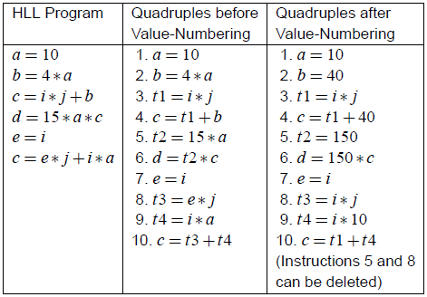
Value Numbering: Example

Slide 27
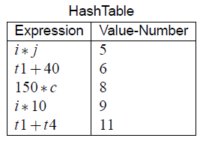
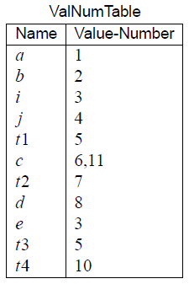
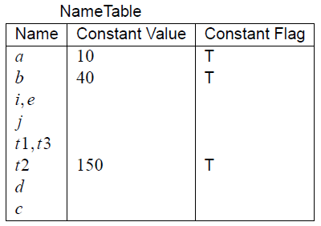
Value Numbering: Example

Slide 28
Value Numbering: Example
a = 10
a is entered into ValnumTable (with a vn of 1, say) and into NameTable (with a constant value of 10)
b = 4 * a
a is found in ValnumTable, its constant value of 10 in NameTable
We perform constant propagation and folding
4 * a is evaluated to 40
b is entered into ValnumTable (with a vn of 2) and into NameTable (with a constant value of 40)
t1 = i * j
i and j are entered into the two tables with new vn (as above), but with no constant value
i * j is entered into HashTable with a new vn
t1 is entered into ValnumTable with the same vn

Slide 29
Value Numbering: Example
Similar actions continue till e = i
e gets the same vn as i
t3 = e * j
e and i have the same vn
e * j is detected to be the same as i * j
since i * j is already in the HashTable, we have found a common subexpression
from now on, all uses of t3 can be replaced by t1
The instruction t3 = e * j can be deleted
c = t3 + t4
t3 and t4 already exist and have vn
t3 + t4 is entered into HashTable with a new vn
Reassignment to c; c gets a different vn, same as that of t3 + t4

Slide 30
Value Numbering: Example
When a search for an expression i + j in HashTable fails, try for j + i
If there is an instruction x = i + 0, replace it with x = i
Any quad of the type, y = j * 1 can be replaced with y = j
After the above two types of replacements, value numbers of x and y become the same as those of i and j, respectively
Quads whose LHS variables are used later can be marked as alive
All unmarked quads can be deleted at the end

Slide 31
Code Optimization
…. to continue

Slide 32
Extended Basic Blocks
A sequence of basic blocks B₁,B₂, …B_{k}, such that B_{i} is the unique predecessor of B_{i+1}(1 ≤ i < k), and B₁ is either the start block or has no unique predecessor
Extended basic blocks with shared blocks can be represented as a tree
Shared blocks in extended basic blocks require scoped versions of tables
The new entries must be purged and changed entries must be replaced by old entries
Preorder traversal of extended basic block trees is used

Slide 33
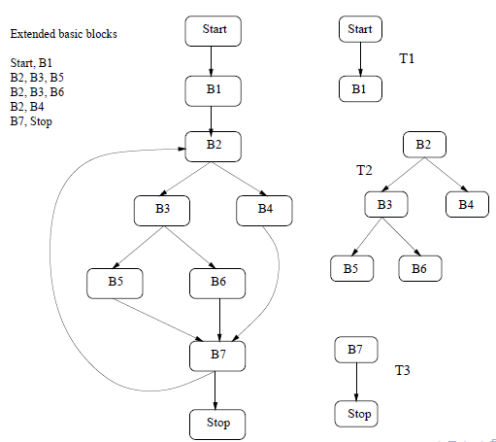
Extended Basic Blocks

Slide 34
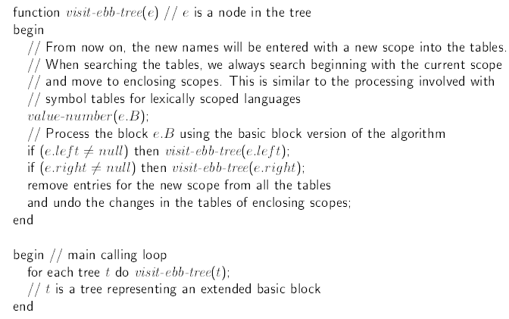
Extended Basic Blocks

Slide 35
Peephole Optimization
A machine dependent optimization technique
Peephole optimizations are replacement rules of the form:
i₁, …, i_{n} → j₁, …, j_{m}
where the RHS is the improved version of the LHS
Example:
move $a $b, move $b $a → move $a $b
Works if move $b $a is not the target of a jump
Another example
addiu $a $a i, addiu $a $a j → addiu $a $a i+j

Slide 36
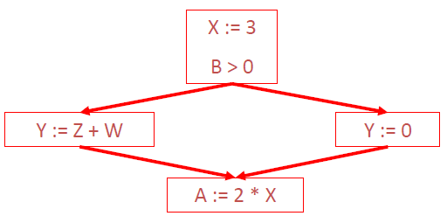
Dataflow Analysis
Simple optimizations over a basic block may be extended over the entire Control Flow Graph (CFG)
Example: Global Constant Propagation

Slide 37
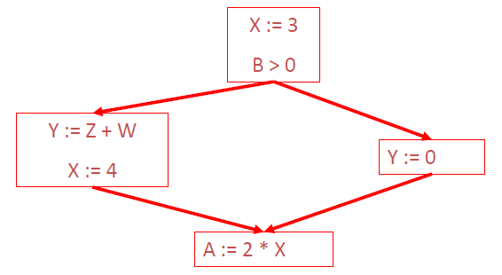
Dataflow Analysis
How do you know it is OK to globally propagate the constant?

Slide 38
Dataflow Analysis
To replace a use of x by a constant k we must know:
On every path to the use of x, the last assignment to x is x = k

Slide 39
Global Optimization
The correctness condition is not trivial to check
Paths include paths around loops and through branches of conditionals
Generally global optimization depends on knowing a property X at a particular point in program execution
Proving X at any point requires knowledge of the entire program
It is OK to be conservative. If the optimization requires X to be true, then want to know either
X is definitely true
Don’t know if X is true
It is always safe to say “don’t know”

Slide 40
Global Constant Propagation
We must know whether:
On every path to the use of x, the last assignment to x is x = k
We associate one of the following values with x at every program point:
┴ (Bottom) : This statement never executes
C : x equals to constant C
┬ (Top) : x is not a constant
For each statement s, the value of x immediately before and after x is calculated
C(s, x, in): Value of x before s
C(s, x, out): Value of x after s

Slide 41
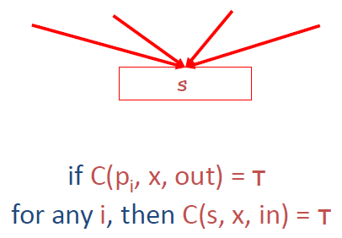
Global Constant Propagation
Rule #1

Slide 42
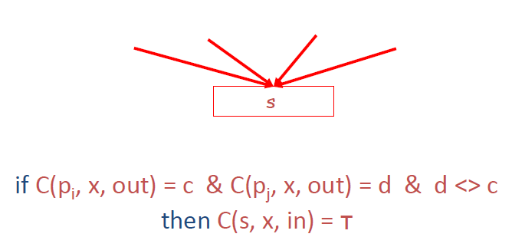
Global Constant Propagation
Rule #2

Slide 43
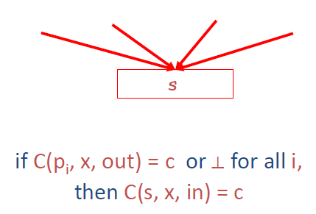
Global Constant Propagation
Rule #3

Slide 44
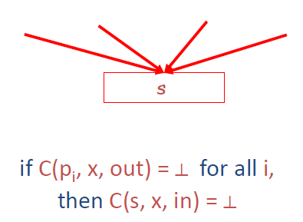
Global Constant Propagation
Rule #4

Slide 45
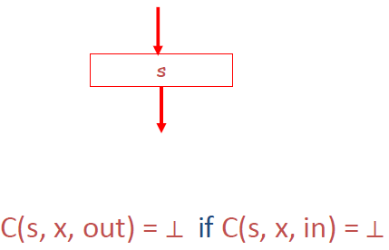
Global Constant Propagation
Rule #5

Slide 46
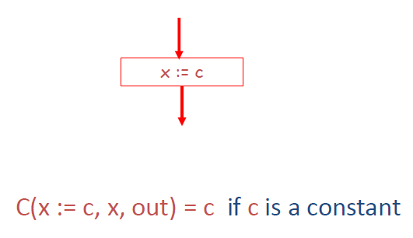
Global Constant Propagation
Rule #6

Slide 47
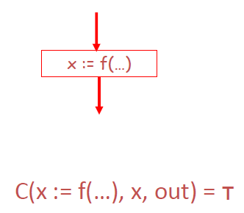
Global Constant Propagation
Rule #7

Slide 48
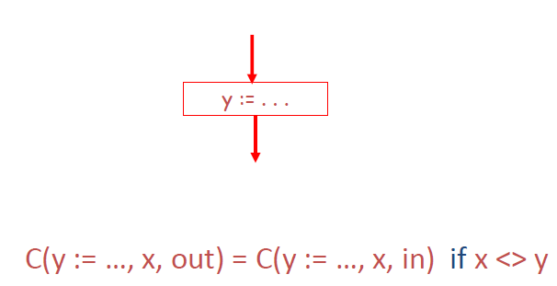
Global Constant Propagation
Rule #8

Slide 49
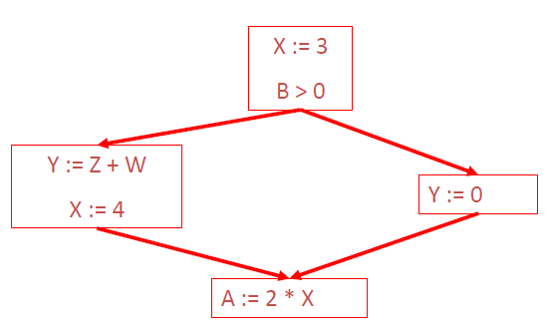
Global Constant Propagation
For every entry s to the program, set C(s, x, in) = ┬
Set C(s, x, in) = C(s, x, out) = ┴ everywhere else
Repeat until all points satisfy 1-8:
Pick s not satisfying 1-8 and update using the appropriate rule

Slide 50
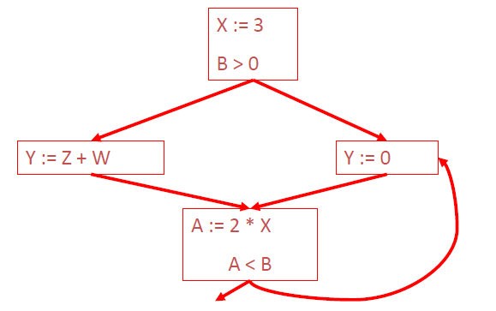
Analysis of Loops
How can global constant propagation for the following CFG be performed?

Slide 51
Liveness Analysis & Register Allocation

Slide 52
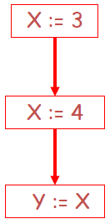
Liveness Analysis
The first value of x is dead (never used)
The second value of x is live (may be used)
A variable x is live at statement s if
There exists a statement s’ that uses x
There is a path from s to s’
That path has no intervening assignment to x
A statement x = … is dead code if x is dead after the assignment
Dead statements can be deleted from the program

Slide 53
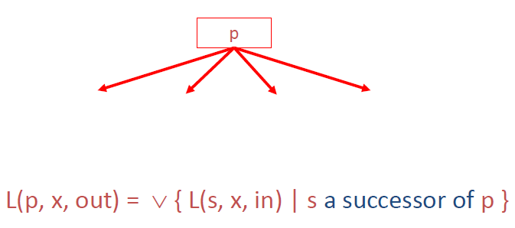
Liveness Analysis
Liveness can be expressed in terms of information transferred between adjacent statements, just as in copy propagation
Rule #1

Slide 54
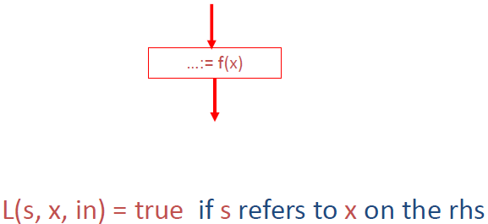
Liveness Analysis
Rule #2

Slide 55
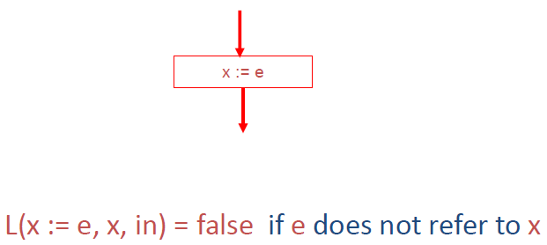
Liveness Analysis
Rule #3

Slide 56
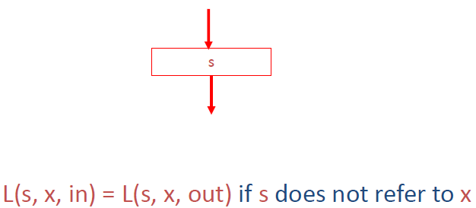
Liveness Analysis
Rule #4

Slide 57
Liveness Analysis
Let all L(…) = false initially
Repeat until all statements s satisfy rules 1-4
Pick s where one of 1-4 does not hold and update using the appropriate rule
x = 0
if (x == 10)
x= x + 1
x is dead

Slide 58
Register Allocation
The process of assigning a large number of target program variables onto a small number of CPU registers
Method: Assign multiple temporaries to one register (many to one mapping) without changing the program behavior
Example:
a := c + d
e := a + b
f := e - 1
r₁ := r₂ + r₃
r₁ := r₁ + r₄
r₁ := r₁ - 1
a, e and f can all be allocated to the same register assuming a and e are dead after use

Slide 59
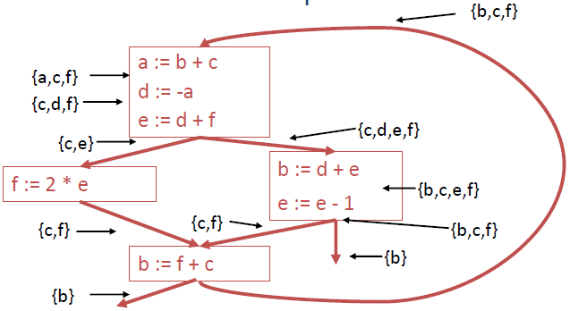
Register Allocation via Graph Coloring
Basic Idea: Two temporary variables t₁ and t₂ can share the same register if at any point in the program at most one of t₁ or t₂ is live.
The variables alive simultaneously at each program point

Slide 60
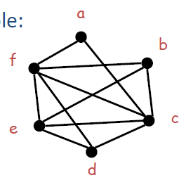

Register Allocation via Graph Coloring
Register Interference Graph (RIG)
An undirected graph
Each temporary variable is a node
Two temporary variables t₁ and t₂ share an edge if they are simultaneously alive at some program point

Slide 61
Register Allocation via Graph Coloring
Graph Colouring: An assignment of colours to nodes, such that nodes connected by an edge have different colors
k-coloring : A coloring using at most k colours.
Chromatic number: The smallest number of colours needed to colour a graph
Independent set: A subset of vertices assigned to the same colour
k-coloring is the same as a partition of the vertex set into k independent sets
The terms k-partite and k-colourable are equivalent
The graph colouring problem is NP-Hard
Heuristics are needed to solve it

Slide 62
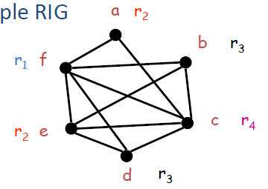
Register Allocation via Graph Coloring
In the register allocation problem, colours = registers
We need to assign colours (registers) to graph nodes (temporaries)
Let k = number of machine registers
If the RIG is k-colourable then there is a register assignment that uses no more than k registers
In our example RIG there is no coloring with less than 4 colours

Slide 63
Register Allocation & Spilling

Slide 64
Register Allocation via Graph Coloring
Graph Colouring: An assignment of colours to nodes, such that nodes connected by an edge have different colors
k-coloring : A coloring using at most k colours.
Chromatic number: The smallest number of colours needed to colour a graph
Independent set: A subset of vertices assigned to the same colour
k-coloring is the same as a partition of the vertex set into k independent sets
The terms k-partite and k-colourable are equivalent
The graph colouring problem is NP-Hard
Heuristics are needed to solve it

Slide 65
Register Allocation via Graph Coloring
In the register allocation problem, colours = registers
We need to assign colours (registers) to graph nodes (temporaries)
Let k = number of machine registers
If the RIG is k-colourable then there is a register assignment that uses no more than k registers
In our example RIG there is no coloring with less than 4 colours

Slide 66
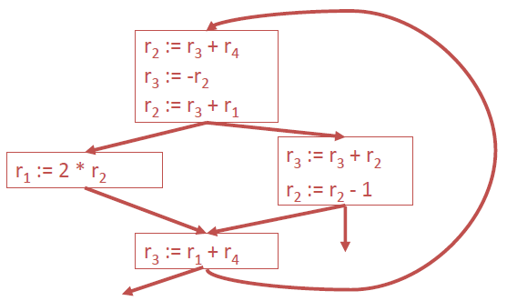
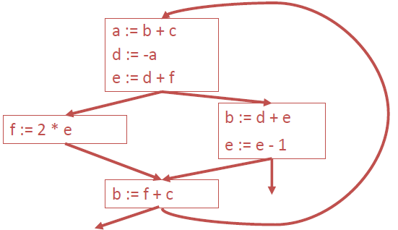
Register Allocation via Graph Coloring
Under the colouring, the code becomes:

Slide 67
Register Allocation via Graph Coloring
A heuristic algorithm:
Pick a node t with fewer than k neighbors
Put t on a stack and remove it from the RIG
Repeat until the graph is empty
Assign colors to nodes on the stack:
Start with the last node added
At each step pick a color different from those assigned to already colored neighbors

Slide 68
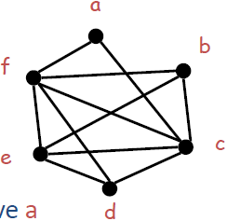

Register Allocation via Graph Coloring
Example: Let k = 4
Initial RIG: Stack: {}
Remove a

Slide 69
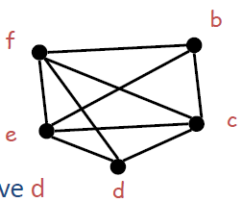
Register Allocation via Graph Coloring
Step 2: Stack: {a}
Remove d

Slide 70
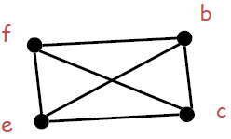
Register Allocation via Graph Coloring
All nodes now have fewer than 4 nodes
Step 3: Stack: {d, a}
Remove any node
Continue removing nodes until the graph is empty
Let the stack be: {f, e, b, c, d, a} after removal of all nodes

Slide 71


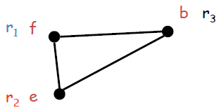
Register Allocation via Graph Coloring
Now start assigning colours to the nodes, starting from the top of the stack
Stack: {f, e, b, c, d, a}
Stack: {e, b, c, d, a}
Stack: {b, c, d, a}
Stack: {c, d, a}

Slide 72
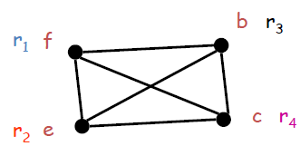
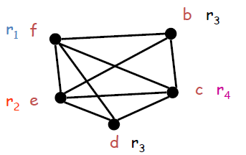
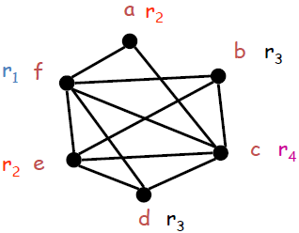
Register Allocation via Graph Coloring
Stack: {d, a}
Stack: {a}(d and b can have
the same register)
Stack: {} }(a and e can have
the same register)

Slide 73
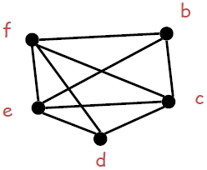
What if the heuristic fails?
Example: Try to do a 3-colouring of the graph:
Remove a and get stuck

Slide 74
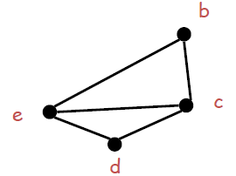
What if the heuristic fails?
Pick a node as a candidate for spilling
A spilled temporary lives in memory
Assume we choose f as a candidate for spilling
The algorithm now succeeds: b, d, e, c
Remove f and continue

Slide 75
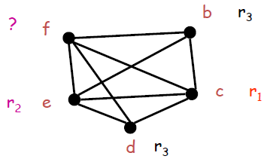
What if the heuristic fails?
On the assignment phase we get to the point when we have to assign a color to f
We hope that among the 4 neighbors of f we use less than 3 colors ⇒ optimistic coloring
The algorithm now succeeds: b, d, e, c
Remove f and continue

Slide 76
Spilling
Since optimistic coloring failed we must spill temporary f
We must allocate a memory location as the home of f
Typically this is in the current stack frame
Call this address fa
Before each operation that uses f, insert
f := load fa
After each operation that defines f, insert
store f, fa

Slide 77
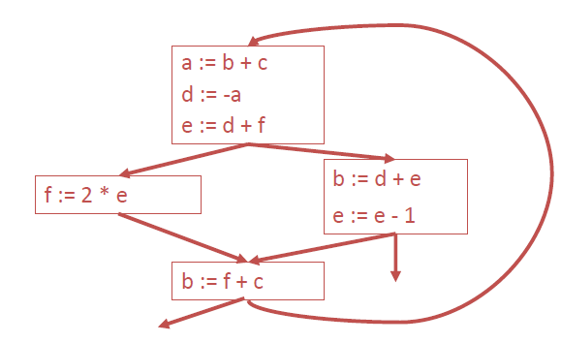
Spilling
Original code:

Slide 78
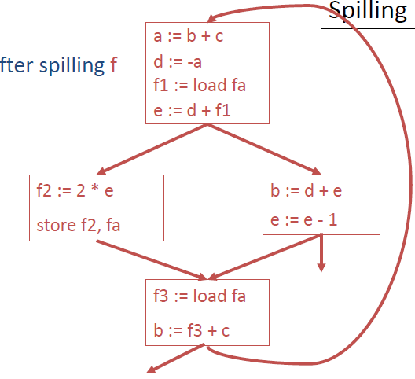


Spilling
Code after spilling:

Slide 79
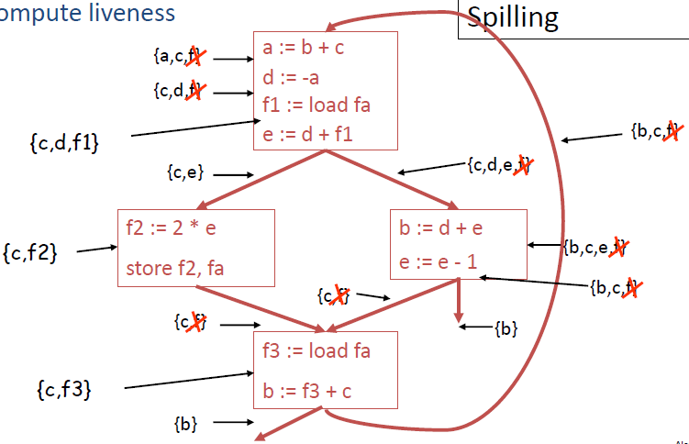



Spilling
Re-compute Liveness:

Slide 80
Spilling
The new liveness information is almost as before
f_{i} is live only
Between a f_{i}:= load fa and the next instruction
Between a store f_{i}, fa and the preceding instruction
Spilling reduces the live range of f and thus reduces its interferences
Which result in fewer neighbors in RIG for f

Slide 81
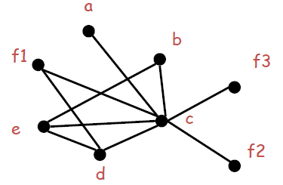
Spilling
With the new liveness information, we need to rebuild the RIG
And try to colour the resulting graph again
Now f only interfaces with c and d
The new RIG is 3-colourable

Slide 82
Spilling
Additional spills might be required before a coloring is found
The tricky part is deciding what to spill
But any choice is correct
Possible heuristics:
Spill temporaries with most conflicts
Spill temporaries with few definitions and uses
Avoid spilling in inner loops

Slide 83
Thanks

Slide 84
An Overview of
Cache Aware Compiler Optimization

Slide 85
Memory Hierarchy
Hierarchical memory Structures:
An attempt to mitigate the growing gap between CPU speed and memory performance
Low main memory bandwidth and high latency
1000
CPU
Processor-DRAM
Performance Gap: (grows 50% / year)
100
Performance
10
DRAM
1
1980
1981
1982
1983
1984
1985
1986
1987
1988
1989
1990
1991
1992
1993
1994
1995
1996
1997
1998
1999
2000
Time

Slide 86
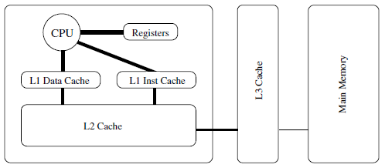
Memory Hierarchy
Registers 1 cycle 256-8000 bytes
Cache (on-chip) 3-10 cycles 256k-1M
Cache (off-chip) 10-20 cycles 1M – 16M
Main memory 20-100 cycles 32M-4G
Disk 0.5-5M cycles 4G-1T

Slide 87
Locality of References
Temporal Locality
The tendency of recently accessed data to be accessed again in the near future
Spatial Locality
The tendency of data located close together in address space to be referenced close together in time

Slide 88
Aspects of Cache Architectures
Cache Line
Holds the contents of a contiguous block of main memory
Cache hits / misses
Data requested by processor is found / not found in cache line
Memory block placement strategies:
Direct mapping
A memory block may be Placed in exactly one cache line
a-way set-associative mapping
Cache lines are grouped into sets of size a
Placement anywhere in corresponding set
Fully-associative mapping
A memory block can be placed into any cache line

Slide 89
Aspects of Cache Architectures
Replacement strategies
Random
Chooses a random cache line for replacement
Least Recently Used (LRU)
Chooses block which has not been accessed for the longest time interval
Least Frequently Used (LFU)
First-In First-Out (FIFO)
Measuring Cache Behaviour: Profiling
Hardware performance counters
Cache hits / misses, pipeline stalls, processor cycles, instruction issues, branch mis-predictions, etc.
Instrumentation
Insert calls to a monitoring library into the program to gather information – gprof does this

Slide 90
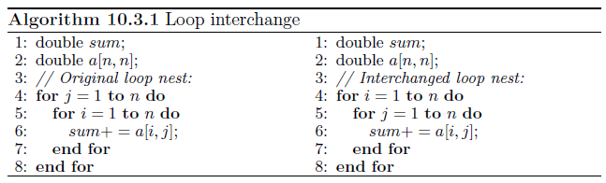
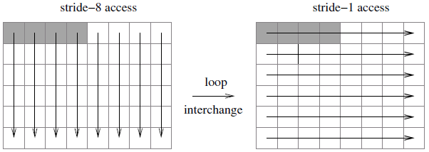
Optimizations
Loop Interchange

Slide 91
Optimizations
Loop Interchange: Example 2
DO J = 1, N
DO I = 1, M
D(I) = D(I) + B(I,J)
ENDDO
ENDDO

Slide 92
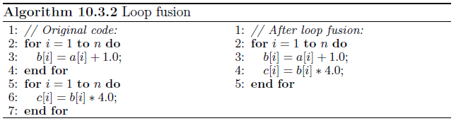
Optimizations
Loop Fusion

Slide 93
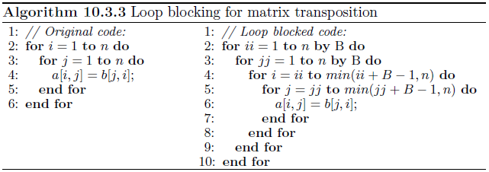
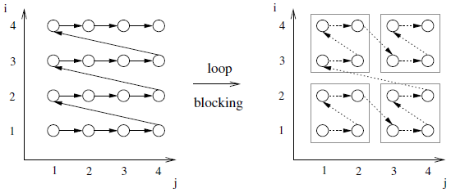
Optimizations
Loop Blocking (or Loop Tiling)

